Slide 1

AI in Blockchain
Group Members
Muhammed Amjad Abdushakkoor (201905111)
Abdallahi Mohamed Mouemel (201910909)
Abdullah Ahmed Alamodi (201407904)
Fahad Bin Shahbel (201707622)

Slide 2
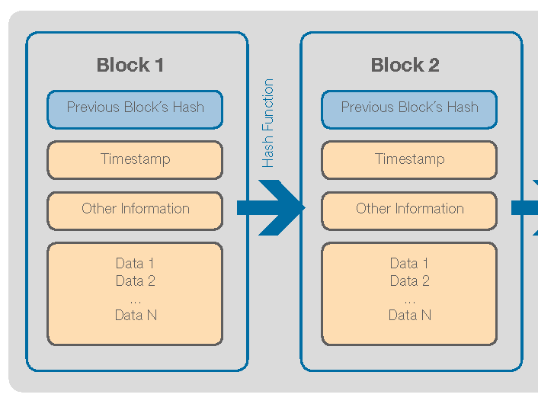
Blockchain
Blocks of data stored in a connected chain
It is not controlled by a central unit
Checked and maintained by many different individuals (also called miners) who will reach an agreement using a consensus algorithm.
Any change that is made in a block can be easily identified as the blockchain is publicly available information and each block contains the hash of the previous block.
If any change is seen or made, the miners will reach a consensus and decide what to do.
Due to the security of the consensus algorithms used and the overall security structure, the blockchain is almost impossible to tamper with, when the most secure hashing algorithms are used.

Slide 3

Blockchain Applications
Currently used to create digital currencies like Bitcoin and Ethereum.
Can be used in messaging applications to provide better cyber security.
Using blockchains for elections can make the process more secure and transparent.
Blockchain has made digital collectibles a reality by guaranteeing exclusivity (Used in NFTs).
Can massively benefit cloud computing and storage industries.

Slide 4
Negatives
When mining a block in a blockchain, miners are going to solve a complex computational problem using brute force. This requires a huge amount of power.
As blockchain is accessed using an application, this app can be attacked, and private information can be stolen. This can be especially true for crypto-wallets.
Another possible attack is the 51% attack. Here, if more than 50% of the miners come together, they can have complete control of the blockchain.

Slide 5
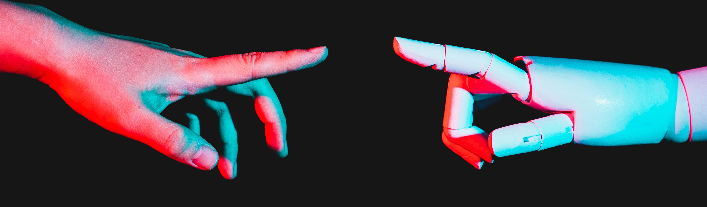
Artificial Intelligence
AI can basically be described as the ability of a computer to do tasks that require intelligence that is similar to humans.
Without any human assistance, computers can collect data and make decisions using it.
It can range from a simple prediction software to a robot that has the ability to think and act.

Slide 6
AI Applications
Can be used to create virtual assistants like Siri or even integrated into apps to provide recommendations based on the collected user data.
Used to increase the productivity of industries where intelligence must come into play.
Cyber attacks and scams can be predicted using AI. It is popularly used as a spam email filter.
Governments can use their country’s data to provide better growth and development in their industries.

Slide 7

Negatives
The huge data collection that is done by many companies for facilitating AI will cause a huge dent in the privacy of people.
Even if data is misused, it can be leaked by attackers or even sold to companies.
Also, Artificial Intelligence, if not controlled properly, can get out of hand and take control of the system.

Slide 8
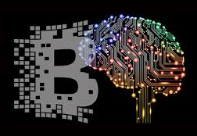
AI and Blockchain Integration
Applications can be developed to take advantages of both technologies.
Examples:
Smart contract vulnerability detection using machine learning.
Smart, efficient, and distributed surveillance systems.
Secure data sources for training machine learning models.

Slide 9
Smart Contract Vulnerability detection using AI
Smart contracts are computer programs deployed on the blockchain, that execute in reaction to transactions.
Smart contracts deal with digital funds, so it is very important that they do not have vulnerabilities ( e.g., DAO incident).
Machine learning models can be developed to scan smart contracts for vulnerabilities before they are deployed.

Slide 10
Conclusion
Considering the risk of security that is caused by every technological progress, blockchain is one of the few technologies that provides hope for privacy. Even with the problems that are present within the blockchain, numerous researches are done to improve it.
There generally is a great future vision in the use of artificial intelligence to achieve goals in the development and civilization of the future and to reach serious results in all technical aspects in all fields and disciplines. However, security and privacy are serious concerns.
When you combine blockchain and AI, blockchain provides the security that AI lacks. All info stored using the technology is required for its proper functioning. Therefore, the information can be stored in blocks under the blockchain network which will almost guarantee the security and privacy of the users.

